Slide 1

Flying Supervisors Course
Maintenance and Operations
Maj Adam Gushaty
Mar 21
Notes:
Hi, My name is Maj Adam Gushaty. Thank you for inviting me to talk to you on your Flying Supervisors’ course. I’m an Aerospace Engineer currently employed at 1 CAD HQ A4 Maint Rdns section as the staff officer for Air Mobility and SAR maintenance operations. Today we’re going to discuss maintenance and operations!

Slide 2
Introduction
Airworthiness
  Who can do what?
  Minimum Equipment List
  In practice at the Tactical Level
Maintenance Support
  1st Line Maintenance
  2nd/3rd Line Maintenance
Scenarios
Notes:
In our presentation today we’re going to start by quickly discussing some high level airworthiness policy, and look at the associated chains of command. We’ll dive a little bit deeper into Technical airworthiness authorizations, of which I’m sure you hold a few, Minimum Equipment Lists (or MELs) and the talk a little bit about how, in practice, airworthiness policies are applied at the Sqns.
Next we’re going to talk a little bit about maintenance support. We’ll discuss first and then second/third line maintenance capacities and some of the operational implications your decisions may have on those capacities.
Last, I have made some scenarios that I hope will generate some discussion points for when we have a chance to talk.

Slide 3
Airworthiness
“The objective of the Airworthiness Program is to provide an acceptable level of safety for military aviation.“
A-GA-005-000/AG-001
DEPARTMENT OF NATIONAL DEFENCE
CANADIAN ARMED FORCES
AIRWORTHINESS PROGRAM
Notes:
One of the most important things to remember is that the objective of the airworthiness program is to provide an acceptable level of safety for military aviation. The main idea behind this program is to balance risk with operational requirement.
We split the operational and technical airworthiness responsibilities at the very top. Many levels of delegation are used to allow risk to be accepted at appropriate levels of command. This provides, at every level of delegation, two halves and encourages conversation.

Slide 4
Airworthiness Chain of Command
Minister of National Defence /
Chief of the Defence Staff
DAODs
Letters of Delegation
Aeronautics Act
Airworthiness
Authority
(AA)
Airworthiness
Investigative
Authority
(AIA)
Operational
Airworthiness
Authority
(OAA)
Technical
Airworthiness
Authority
(TAA)
Chief of the
Air Staff
Director of
Flight Safety
Commander
Air Division
Director General
AEPM
DND/CF A/W Program
A-GA-005-000/AG-001
Flight Safety for the CF
A-GA-135-001/AA-001
1 Cdn Div Order
1-623
TAM
C-05-005-000/AG-001
ADSM
C-05-005-000/AG-002
Notes:
The airworthiness program is slightly more complicated than just the 2 halves, but for today’s discussion we’re going to focus on the TAA, the OAA, their delegates and the interactions between them.
Most notably, it is important to consider how those interactions can maximize support to daily flying programs and air force operations.
4 Authorities. Many layers of policy.
Of note, the ones that impact Tactical Level Operations are the OAA and the TAA, who each delegate down to the AC and the SMMs at the Sqn level.
OAA Policy:
Operational Airworthiness Manual
FOM
Wing Flying Orders
Sqn Flying Orders
Standard Maneuver Manual
SHOPs
TAA Policy:
- Technical Airworthiness Manual
- P-Series
- AF-9000 Processes

Slide 5
Who can “Technically” do What?
Technical Authorization:
  Apprentice: Conduct maintenance under the supervision of a POM and conduct any elementary and serving tasks for which they are qualified and authorized.
  Performance of Maintenance (POM): Conduct and sign for maintenance actions for which they are qualified and authorized.
  Level A Maintenance Release: Sign for the completion of maintenance tasks and defer defects that do not increase the airworthiness risk of the aircraft.
  Level B Maintenance Release: Sign for the completion of servicing/elementary work for which they are qualified and authorized (generally aircrew: AC or FE) and release the aircraft for flight.
  Level C Maintenance Release: Release an aircraft from maintenance to an authorized aircraft commander for a specific mission.
  Senior Maintenance Manager (SMM): Impose Operational Restrictions, exercise unique authorization space, and request deviations from the approved maintenance program.
Notes:
There are a number of authorizations, outlined in the P-Series, that help the tactical organization ensure that safe aeronautical products are provided to the operators. There exist a number of spaces that provide for “interpretation” and risk acceptance. Quite appropriately, only an acceptable level of risk associated with systems that are not critical for flight are delegated to the tactical level.
Under normal circumstances, we assume that aircraft maintenance will follow the prescriptive program and ensure through many levels of review that tasks are completed to an acceptable standard. This is the ultimate responsibility, at the tactical level, of the Senior Maintenance Manager, a delegated authority, that normally lives in the most senior maintenance individual in the Sqn.

Slide 6
Minimum Equipment List
Aircraft type specific
Pre-approved assessments and solutions for unserviceable aircraft systems
“Must Follow”
Notes:
Minimum Equipment Lists are fleet specific, and are not a document that is required by airworthiness policy. It is an optional document, approved by both the Technical and Operational Airworthiness Authorities, that aims to provide additional flexibility for issues that normally exceed the risk acceptance authority at the tactical level. If a fleet has decided to implement an MEL, and has a currently approved version, it is an airworthiness document and needs to be followed.
Sometimes, however, we have noticed that the wording in MELs can be overly restrictive and an operational organization can find itself constantly requesting deviations to support operations. These documents can be updated, re-written, or even rescinded if they find themselves hampering operational effectiveness.

Slide 7
Airworthiness in Practice
At the Sqn Level:
Work together to find Acceptable Level of Safety solutions:
  Defer defects and Impose Ops Restrictions or MMEL
Technical Representative:
Senior Maintenance Manager
(SAMEO or other authorized individuals)
Operational Representative: Aircraft Commanders
(Pilot)
Solutions that are beyond tactical authorization need to include DGAEPM and 1 CAD HQ
Notes:
At the tactical level, we find that the SMM (normally the SAMEO) and their delegates communicate directly with the Aircraft Commanders. Normally, they conduct a rather informal Initial Airworthiness Risk Assessment. If appropriate, and with the support of the Level A maintenance technician, corrective maintenance can be deferred and ops restrictions can be imposed to allow for use of an aircraft that would otherwise be unserviceable.
Of course, any risk that exceeds that delegated to the tactical level will be raised to the appropriate TAA and OAA levels for acceptance prior to aircraft release.

Slide 8
Maintenance Support
Maintenance exists to support operations
Complicated 2nd and 3rd order effects to operational decisions and changes
Flexibility is the key to air power, but it is not infinite
Better planning = higher output
Your SAMEO is your Maintenance expert. Good communication is key!
Notes:
Enough about airworthiness. Let’s talk about your Sqn. Specifically, I’d like to discuss the Maintenance Organization as a resource. Finite, but flexible, the Maintenance Organization exists to support operations.
The Maintenance section is likely filled with very smart people that are very committed to operations. But, they do exist under a framework that constrains them somewhat. Fortunately, the SAMEO and their team likely have a good understanding of what those constraints are, and how some operational decisions may positively or negatively affect things like aircraft serviceability or support to particular operations.
I would like to emphasis that good planning, inclusive of both aircrew and maintenance considerations, is likely the only way to maximize output. Having a solid relationship with your Sqn SAMEO is extremely important.
There are two general types of maintenance organization, and I’d like to explore their purpose and limitations in the next couple slides:

Slide 9
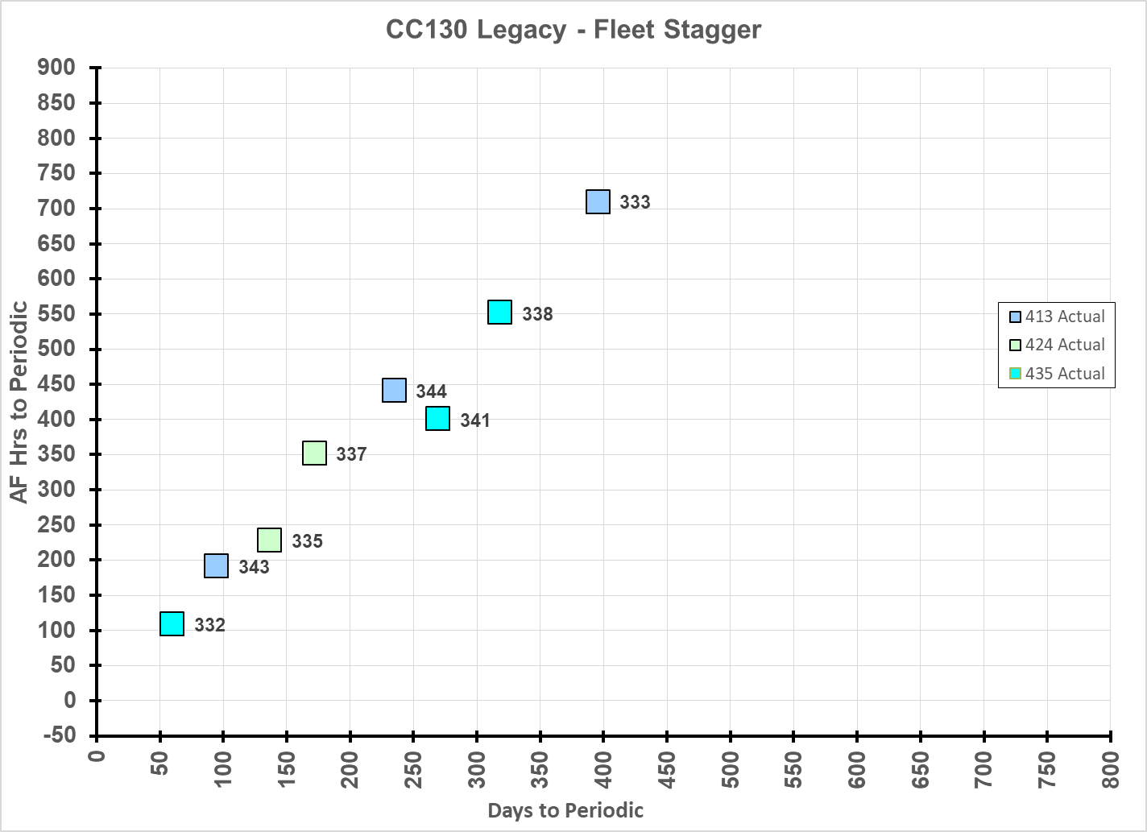
1st Line Maintenance
Support to daily flying program
Configuration Changes
Elementary and Servicing Tasks
Corrective and small Preventative Maintenance tasks
Capacity defines number of flights that can be supported in a day by which aircraft
Notes:
The First Line maintenance organization exists to support daily flying operations. It includes technicians that are authorized to service and repair aircraft, but only to a limited degree of complexity.
Generally, they perform configuration changes, conduct servicing and elementary tasks like filling tires and refueling, and more complicated corrective/preventative maintenance that generally takes less that 1 month to complete like SUPPs for example.
They are mainly constrained by the number of personnel, availability of parts and/or support equipment, or number of work hrs/day.
Their output is number of aircraft that can be repaired per day, and the effectiveness of the 1st Line maintenance can be measured by counting the sustainable number of sorties per day that be supported.
Some considerations, like the aircraft stagger presented in the right corner, need to be managed to ensure overall fleet health. As such, there may be times where aircraft are available to be flown, but can not be without accepting significant risk.
This is some of the complexity that your SAMEOs track regularly, and may form the basis for some of the discussions they have with you about asset availability.
But, It would be far too easy if that were the only part we needed to concern ourselves with.

Slide 10
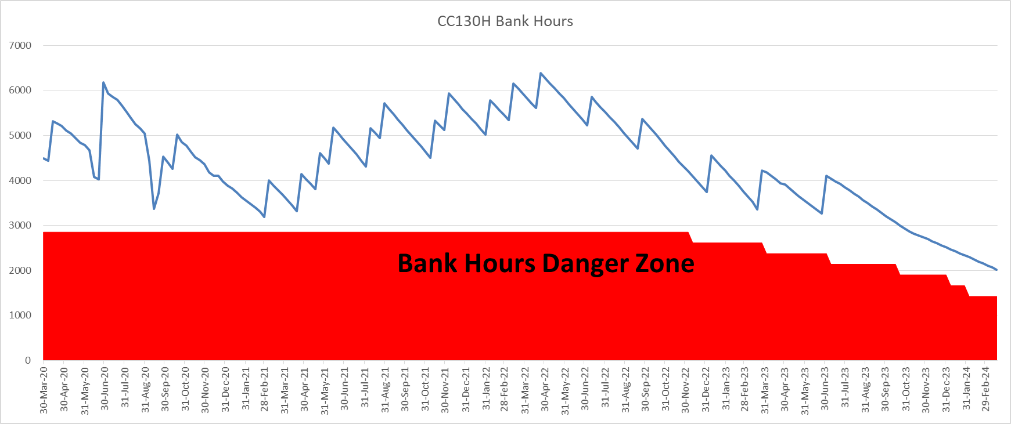
2nd/3rd Line Maintenance
Long Term Preventative Maintenance and Corrective Tasks
Off-aircraft component repair
Capacity defines yearly YFR that can be supported
Notes:
The Second Line maintenance organization exists to conduct longer term complex corrective and preventative maintenance, including both aircraft and off-aircraft work. This includes all the second line shops (tire bay, tank bay, armament storage, etc…) as well as aircraft Periodic and Third Line Inspection and Repair (TLIR). These functions can be accomplished by RCAF technicians, but have more recently often been contracted.
The constraints of the 2nd line are very similar to those at first line: the number of personnel, availability of parts and/or support equipment, or number of work hrs/day.
Their output is number of aircraft/parts completed in a year. Their effectiveness can me measured, for a Periodic/TLIR, by tracking the total flying hours against the number of airframe hours generated by completing inspections. One would hope these are balanced. The above graph is an example of the CC130H fleet’s “Bank Hours” over time, where the blue line tracks total available fleet hrs. You can see that the fleet operates regularly above the “danger zone” and remains healthy by returning hrs (completing inspections) at a similar rate to that which hrs are consumed.
Normally, the SAMEOs and the staff at 1 CAD track this together with our operator counterparts to ensure that we are providing the required amount of flying. If, however, flying and maintenance become unbalanced, there risks significant impact to future support.

Slide 11
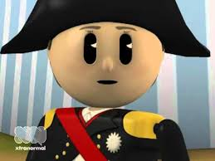
How do we Fly More?
Have you tried adding more jets to the program?
1st Line Operations Planning!
  Detailed planning at least 2 weeks out
  Keep something in reserve (plan to ~75% of 1st Line Maint Capacity)
  Minimize changes (launch times/configurations)
  Talk to your SAMEO
2nd/3rd Line Resource Limitations
A balance between 1st and 2nd Line is essential
Notes:
Consider that we’re talking about a certain number of resources. Certainly, if viewed that way, it is rather obvious that there is a maximum that we can expect. But there are things that can make things more, or less, efficient.
For the first line, we find that when we exercise flexibility by changing schedules, configurations, or flying programs, it costs maintenance resources to reorganize. And that’s the trick. The more flexibility you need, the less an organization will actual accomplish. On the other hand, the better an organization plans (and sticks to it) the more that these resources can be maximized. It’s a difficult balance to strike, especially for military operations. Flexibility is required, but we also don’t have infinite resources.
Same goes for the second line, though the effects are less immediately felt.
Lastly, it’s important to understand that all levels of maintenance need to reflect the desired operational efficiency/flexibility balance. The best way to get everything to line up is to have Maitnenace and Ops working closely together to understand and posture for best support.
When do we need to fly? How many aircraft to we need to fly at the same time? What are standby requirements? What risks to the planned program if we fly?

Slide 12
The Importance of Balance
Airworthiness Risk with Operational Imperative
Daily Flying program with 1st Line Capacity
  (maximised though good planning)
Yearly Flying Rate with 2nd/3rd Line Capacity
  (Surge can be leveraged when followed by reconstitution)
Talk to your SAMEOs
Notes:
In your Squadrons, at the tactical level, it is important to balance operational requirement and risk. Daily flying (first line) and YFR generation (second line) need to be balanced. If one organization is “doing better” at the expense of another, the holistic system will start to fail.
Your SAMEOs know these intricacies all too well. I cant emphasis enough how important it is to have a good relationship with them and to help them understand the operational requirements, including requirements for flexibility. They hold the keys to vehicles that can drastically affect a Sqn’s success.
I have a few scenarios that I would like you to read, and some points for consideration. Depending on your fleet, the answers may differ. In fact, I specifically chose some that will be drastically different. I would like to encourage some discussion, and focus on the impact that SAMEOs decisions can have on your ability to support operations (first 2) and the impact that your decisions can have on your mission or even the fleet (last 2).
I look forward to talking with you in the coming days.
Thank you.

Slide 13
Scenario 1
You are returning from an exercise and have to make 2 stops on the way to refuel. At your last stop, you notice that radio #2 is U/S and will not power-on.
What should you consider?
Notes:
Do you need it?
Is it in your MMEL?
How can you fly home?

Slide 14
Scenario 2
You have been tasked to complete a SAR mission that will be day/VFR. There is no forecasted precipitation, sky clear, and OAT ~20°. You are informed, following the pre-flight, by your FE that the pitot heater on system #2 is not working on your assigned aircraft.
What should you consider?
Notes:
Is there a backup aircraft?
Do you need it?
Is it in your MMEL?
Speak with SAMEO and consider Ops Restriction?

Slide 15
Scenario 3
You are away from your home base, and your TCM (or FE) is sick (unable to perform anything). The aircraft is serviceable but needs an after-flight check and needs to be refuelled.
What should you consider?
Notes:
Who else is authorized to conduct the task?

Slide 16
Scenario 4
You have been asked to plan support to a northern exercise that has been allocated 50hrs of YFR. You know that you can get some very good training in transit, but requires 25hrs extra and takes you off of the tasked transit route.
What should you consider?
Notes:
What 1st Line maintenance concerns could I encounter (Snags, Preventative Maintenance, etc…)?
What parts/tools/techs are with me to mitigate the above risks?
Does the aircraft I’m assigned have the hrs to support the extra flying? What impact would that maybe have on my fleet management?
Does the fleet have the capacity to accept my 25hrs of FG, or will that impact something else that is planned?

Slide 17

Questions

Slide 18


Presentation Tools
On pages where inserted graphics or tables cover markings:
  Copy/Paste the appropriate set
  Right Click and make sure to “Bring to Front”
  Use the Drawing Tools Format toolbar
    ALIGN
      Centre and TOP for the Top justified marking
      Centre and BOTTOM for the Bottom justified marking
CAN SECRET//REL FVEY
CAN SECRET//REL FVEY
CAN CONFIDENTIAL//REL FVEY
CAN CONFIDENTIAL//REL FVEY
TOP
BOTTOM
CAN UNCLASSIFIED / CAN SANS CLASSIFICATION
CAN PROTECTED A / CAN PROTÉGÉ A
CAN UNCLASSIFIED / CAN SANS CLASSIFICATION
Hidden Slide
CAN PROTECTED A / CAN PROTÉGÉ A

