Slide 1

Flying Supervisor Course CM / PD
Brief
Maj Corey Taylor
D Mil C / DCM 4-6
ACSO / AOO Career Manager
Lt - Maj

Slide 2
BRIEFING OVERVIEW
DGMC / D Mil C
Professional Development
Communications
Postings
Promotions
  Selection Boards
  SCRIT
  PaCE
Notes:
2
Updated 15 Dec 21

Slide 3
DGMC / D MIL C

Slide 4
DGMC
DGMC / DGCM
BGen Gallinger
D Mil C / DCM
DSA / DNS
DMCA / DACM
DMCPG / DPGCM
DMCSS / DSSCM
Career Management
Senior Appointments
Military Careers Admin
Policy & Grievances
Military Careers Support Services
Col Frederickson
D Mil C 2 / DCM 2
D Mil C 3 / DCM 3
DMCA 2 / DACM 2
DMCA 3 / DACM 3
Navy / Marine
Army / Armée
Admin Review
Examen Admin
AR/MEL
EA/LEM
D Mil C 4 / DCM 4
D Mil C 5 / DCM 5
DMCA 4 / DACM 4
DMCA 5 / DACM 5
CF Drug Control/
Contrôle des drogues
Air Force / Aviation
Common / Commun
Release/TOS
Libération/CS
LCol Wright
D Mil C 6 / DCM 6
Support
DMCA 6 / DACM 6
Soutien/Admin
Notes:
Updated 15 Dec 21
Mission
To provide timely career management and administrative support services within an adaptive personnel management framework to ensure that the Right Person with the Right Qualifications in the Right Place at the Right Time and for the Right Reason (in the right number) (6 Rs)
Vision
To be an innovative team that delivers a transparent, effective and collaborative personnel management system that will ensure operational readiness and support institutional requirements of the CAF

Slide 5
D MIL C 4
D Mil C 4 / DCM 4
LCol Curtis Wright
Coord
Maj Stephenie Dickert
D Mil C 4-2 DCM
Maj Vincent Landry
Pilot Ftr / Trng
D Mil C 4-6 DCM
Maj Corey Taylor
ACSO LRP / Trng
D Mil C 4-7 DCM
Maj Steve Buckley
AEC
D Mil C 4-8 DCM
Maj Ryan Harnum
G Aero
D Mil C 4-3 DCM
Maj Tyler Thorbergson
Pilot FW
D Mil C 4-8-2 DCM
MWO Daryll Wilts
AM Sup (MWO)
D Mil C 4-8-3 DCM
MWO Les Obbagy
AM Sup (WO)
D Mil C 4-6-2 DCM
MWO Bruno Lapointe
FE / AES Op
SAR Tech
D Mil C 4-7-2 DCM
MWO Myriam Lafrance
AC Op
D Mil C 4-8-7 DCM
MWO Fred Viens
AVS Pte-MCpl
D Mil C 4-8-4 DCM
MWO Yannick Gariepy
Tous/All Air Tech Sgt
D Mil C 4-4 DCM
Maj Sylvie Collins
Pilot RW
D Mil C 4-8-5 DCM
MWO J-F Tremblay
Avn MCpl, AWS Pte-MCpl
D Mil C 4-8-6 DCM
MWO Nicolas Ferland
ACS/NDT Pte-MCpl
D Mil C 4-5 DCM
Maj Louis Martel
ACSO MH/AM/EW
Const Eng
D Mil C 4-8-8 DCM
WO Dan Bujold
AVN Pte-Cpl

Slide 6
DIRECTOR MILITARY CAREERS (D Mil C)
Guiding Principles:
Fairness
Transparency
Consistency
Flexibility
Responsiveness
Innovation
Integrity
Ref: Director General Military Careers

Slide 7
PRINCIPLES OF CM
Balancing the CAF and the member’s needs
Svc Reqts
Staffing reqts
Specific quals
Career prog
Succession Planning
ECs
- Attrition
Mbr Prefs
Spousal empl
Dependent educ
Aging parents
Marital status
Home ownership
- Stability
CM

Slide 8
POSTING CYCLE
Nov – Feb
Conduct Interviews
Develop Posting Plot
Initiate Screenings
Feb – Apr
Solidify Posting Plot
Continue Screening
Initiate Postings
CM
Interviews
Posting
Plot
Misc. Staff work
Conduct File Reviews
Merit
Boards
Promotions
& Postings
Aug – Nov
SBCL Audit
Board Prep
Manage Boards
Stats for AMOR
Apr – Aug
SBCL Prelim Audit
Postings
Promotions

Slide 9
RESPONSIBILITIES
Members
Research APS Openings
  Discuss with incumbent and CoC
Update posting preferences (EMAA, CoC, CM)
Update MPRR (marital status, dependants, education, training, qualifications)
Research and decide on TOS
Obtain PER
Do not let language profile expire
Do not let Force test expire
Seek Medical Care if Ill or Injured
Come prepared to CM interview by having done tasks above

Slide 10
Postings
Affectations
Notes:
Updated Sept 2019

Slide 11
SCREENINGS
Most cases of early repatriation are a direct result of improper or incomplete screening
COs must assess many factors including the following:
  History of repeated misconduct
  Serious marital problems
  Medical and emotional stability and capacity to adapt
  Schooling facilities
  Heavy indebtedness
  Evidence of over-indulgence (alcohol, drugs)
It is imperative that the member, CM and losing and gaining unit COs work together to ensure the selected candidate is the right candidate
Refs: A. CFAO 20-50
DAOD 5009-0
CANFORGEN 097/17
CANFORGEN 177/05
CANFORGEN 052/11

Slide 12
IMPOSED RESTRICTION (IR)
Members can request, in writing thru their CoC, IR status to their CM following a restricted move
  Request memo with CO support and completed IR questionnaire required
The CM is the IR approving authority
IR approval is limited to 1 year at a time to a maximum of 5 consecutive years
CO is authority to cease IR
CAF Military Personnel Instruction 01/17

Slide 13
POSTING IN SUPPORT OF MEMBERS
Contingency Cost Move (CCM):
Vacancy must exist at gaining unit
Exceptional circumstances
Resolvable
Deployable
Employable
Duration: normal posting
If unresolved after the posting:
  Compassionate Status
  Posting despite situation
  Release
Ref: DAOD 5003-6 Contingency Cost Moves for Personal Reasons, Compassionate Status and Compassionate Posting
Notes:
* What seems to be an “exceptional circumstance” to a member may not be truly exceptional (i.e. aging parents).

Slide 14
POSTING IN SUPPORT OF MEMBERS
Compassionate Posting:
Vacancy must exist at gaining unit
Exceptional circumstances
Resolvable
Situation that affects the ability to perform duties
Not Deployable
Duration: 2 yrs, with potential 1 yr extension
If unresolved after the compassionate period:
  Compulsory Release may be required
Ref: DAOD 5003-6 Contingency Cost Moves for Personal Reasons, Compassionate Status and Compassionate Posting
Notes:
* What seems to be an “exceptional circumstances” to you may not be one per se (i.e. aging parents).
* Ce qui peut vous sembler être une « circonstances exceptionnelles » pourrait s’avérer ne pas en être une (ex. : le vieillissement de vos parents).

Slide 15
Professional Development

Slide 16
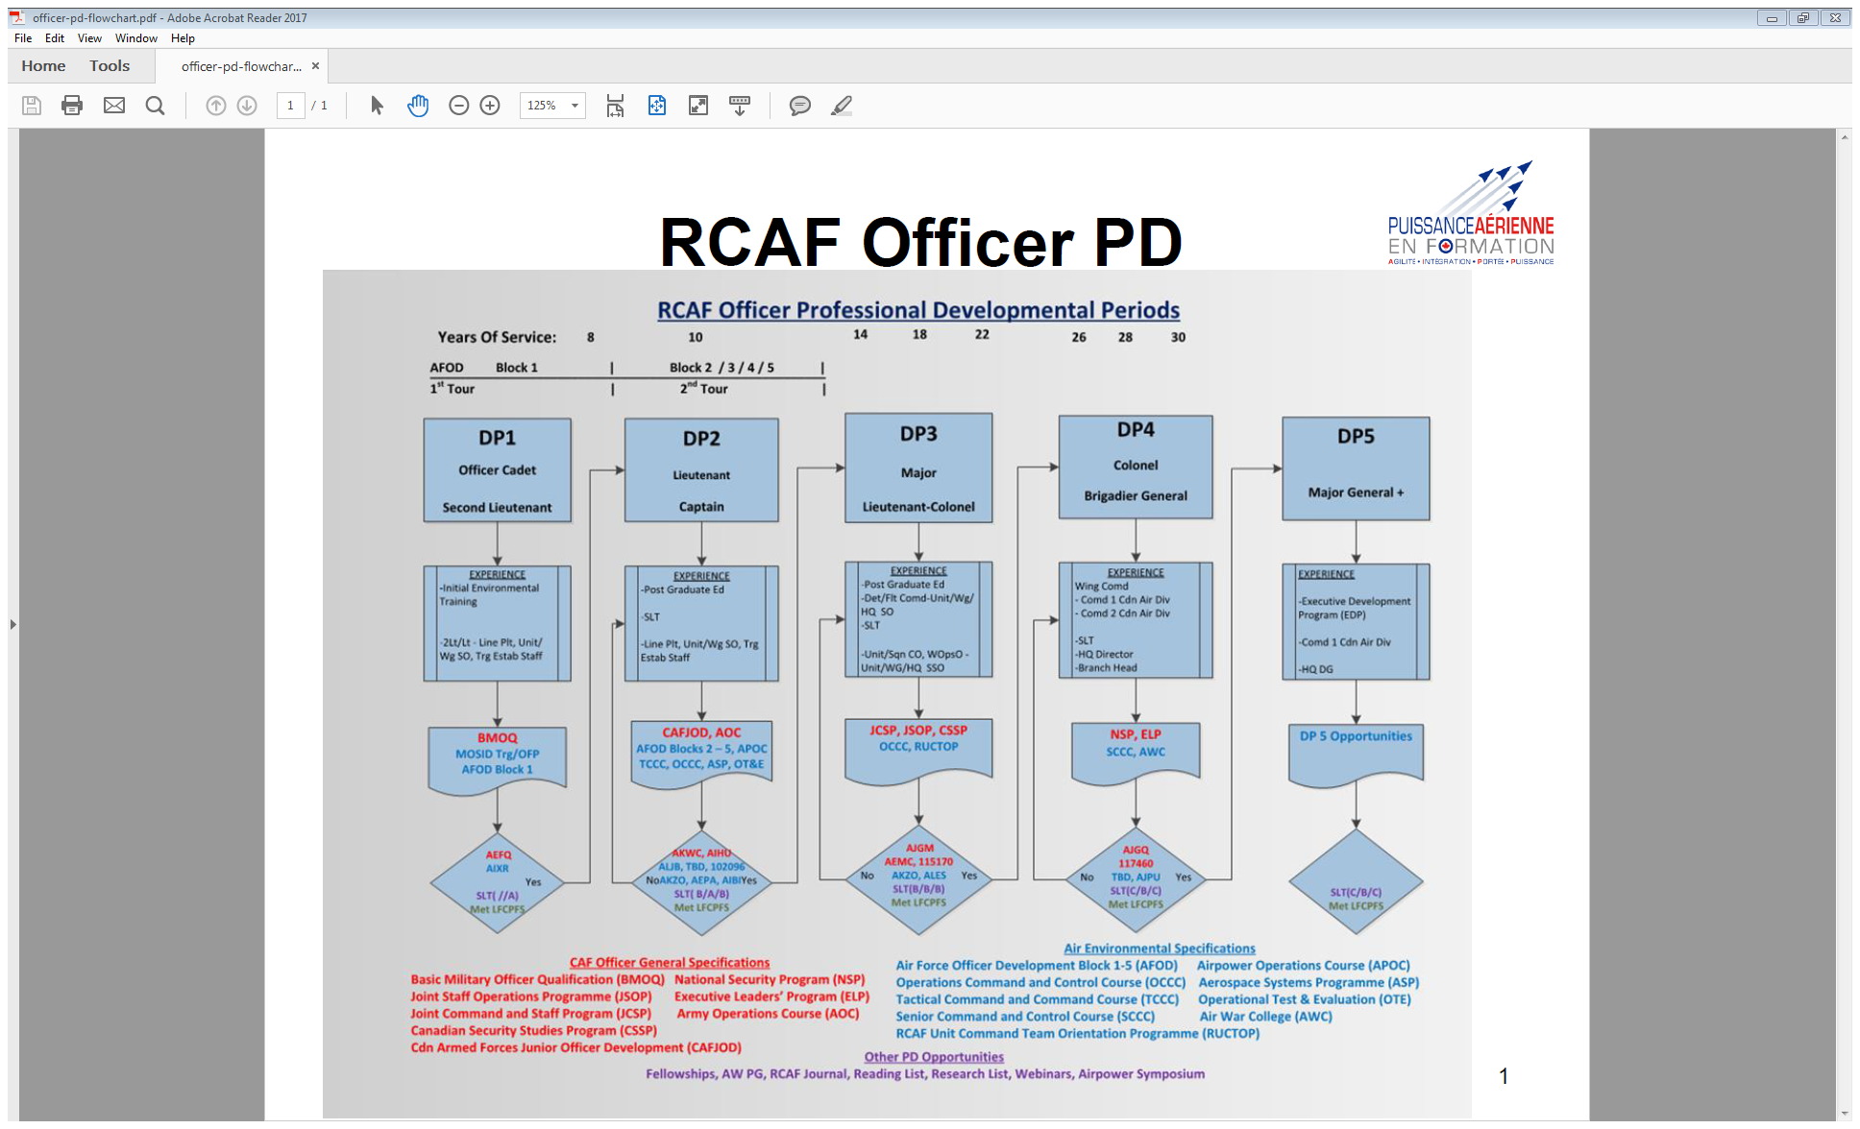
RCAF Officer PD Periods
Ref: http://rcaf.mil.ca/en/2-cad/rcaf-pd/rcaf-pd.page

Slide 17
DEVELOPMENT PERIOD 2 (DP 2)
AFOD mandatory for promo to Maj
  If commissioned after 1 Jan 03
  For ACSO, AEC, AERE, CELE, CE and PLT (and AOO)
AFOD pre-requisite for ASPOC
AOC is equivalent to AFOD 4&5
CAFJOD mandatory for promo to Maj
  Completion of CAFJOD (mod 1 to 7) is required; and
  Completion of GBA+ Course
CAFJOD equivalency. In addition to GBA+, officers must complete a combination of six courses from the CAFJOD , OPME and/or O-DP2 Programmes, IAW Ref.
CANAIRGEN 015/17 IMPROVEMENTS TO RCAF OFFICER PROFESSIONAL DEVELOPMENT
RCAF Aerospace Warfare Centre (ASPOC info)
Ref: CANFORGEN 007/19 CMP 003/19 191956Z Dec 18
Notes:
AFOD only mandatory if commissioned after 2003, but members who joined prior will not get SCRIT points at the Board if they don’t have AFOD completed
- Effective since 2019
AFOD Block 5 Pre-Requisite for ASPOC is now a “hard requirement” – No more bypass/waivers.

Slide 18
POST-GRADUATE TRAINING
The Regular Force requires officers with certain skills and knowledge that can only be acquired through PGT
Must gain University admission & meet specific academic requirements
Sponsored
Obligatory Service
Must have sufficient TOS to cover subsequent Obligatory Service
Applications to DMCPG 5-2 IAW CANFORGEN
Many positions go unfilled
http://cmp-cpm.mil.ca/en/recruitment-careers/education-programs/post-graduate-training-sponsored.page

Slide 19
JOINT COMMAND & STAFF PROGRAMME
Eligibility Criteria (foreign and DL equivalent)
Demonstrate potential to attain the rank of Col within time remaining to serve
  Later of CRA 55/60 or 35 years of service
Min of 10 years of service remaining as of 1 Apr of course start
Have a second language profile of BBB or better
Specific Number of Seats for each Occupation
OUTCAN Options
50% must be O3 listed
Ref: ACO 1000-7 Air Force Personnel Management - Officers
Notes:
10 YOS and some interpretation may be occupation dependant, but AFO outlines process and hard requirements

Slide 20
CAF EDUCATION REIMBURSEMENT PROGRAMS
Education Expense Reimbursement (EER) Program
New Policies, Processes and Software
Seeks to Modernize EER and provide long-term sustainable program accessible to all Reg F and PRes members
DESIGNED TO BALANCE THE MEMBER S SELF DEVELOPMENT NEEDS AND INSTITUTING RESPONSIBLE RESOURCE MANAGEMENT. THE FUNDING MODEL WILL BE COURSE BASED USING A PRIORITIZATION MATRIX TO BE PUBLISHED ON THE CDA WEBSITE
THE IMPLEMENTATION OF THE CAFSDP AND SDPEER SOFTWARE APPLICATION SIGNIFY THE REOPENING OF EER OPPORTUNITIES AND FUNDING TO ALL REG F MEMBERS AND
A NEWLY CREATED EER PROGRAM THAT IS SPECIFICALLY DESIGNED TO SUPPORT ILL AND INJURED REG F MEMBER TRA
Refs.: CANFORGEN 103/21 Release of CF Mil Pers Instr 01/21
CF MIL PERS INSTR 01/21 CANADIAN ARMED FORCES SELF DEVELOPMENT PROGRAM (CAFSDP)

Slide 21
Second Official Language Training
- French language training designed to prepare members for the Second Language Evaluation (SLE) to achieve A, B and C profiles
- Flexible training options to improve proficiency in French reading, writing and speaking include:
  Online full-time courses via virtual classroom (6 weeks)
  Online part-time tutorial courses for levels A and B (6 months)
  Face-to-face courses* offered at the following locations:
    Downtown, Ottawa
    Asticou Center, Gatineau
    CFB Borden
    Canadian Forces College, Toronto
    St-Jean Garrison
CFLS webpage: http://cfls.mil.ca/index-eng.asp
Notes:
*COVID permitting

Slide 22
Preferred Language of Instruction
As of 21 Jan 2022, military mbrs will be able to select their preferred language for courses/instruction in Guardian.
Mbrs are to go to their OR to update that information.
This will be also be included in the APRV checklist.

Slide 23
Communications
Notes:
Updated Sept 2019

Slide 24
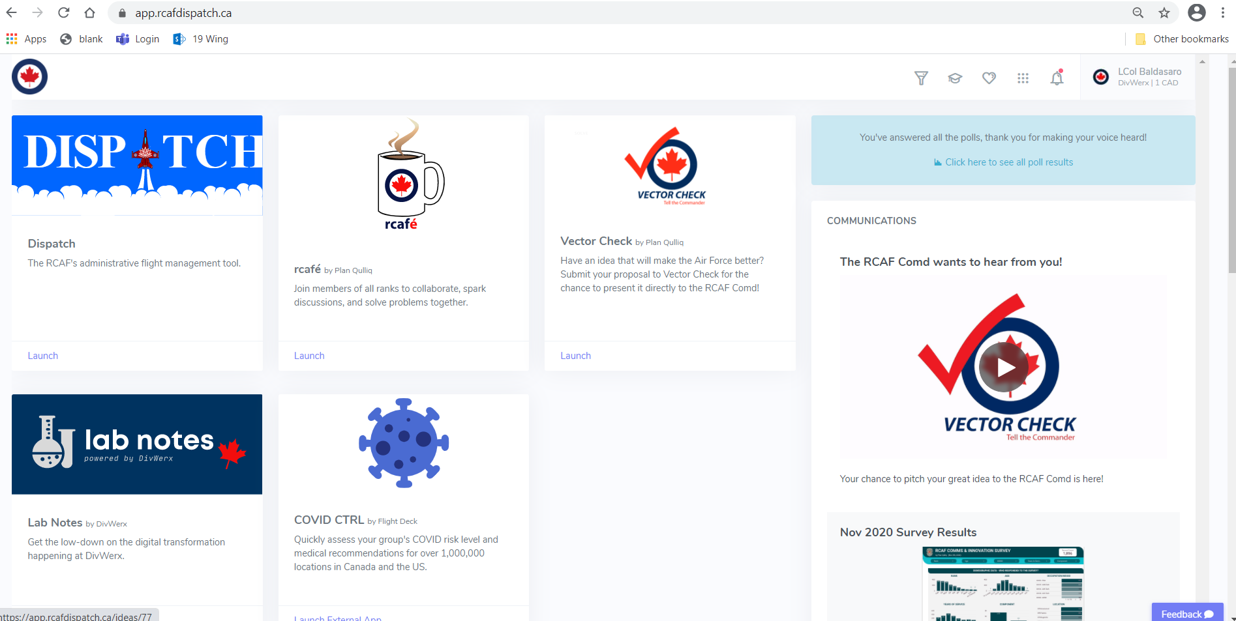
rcafé
RCAF ONLINE Resources
https://app.rcafdispatch.ca
Notes:
COMMUNICATION CHANNEL – RCAF information channels, including PD, latest initiatives and other topics.
Venues for RCAF members of all ranks to collaborate, spark discussions and solve problems.
A communication venue to reach all RCAF members directly – rcafé was unrolled using modern agile software development and devops methodology.
Innovation message is focused on sparking discussions to establish trust and connectivity within RCAF membership and engagement at all levels to ensure all ranks that the leadership is listening.

Slide 25
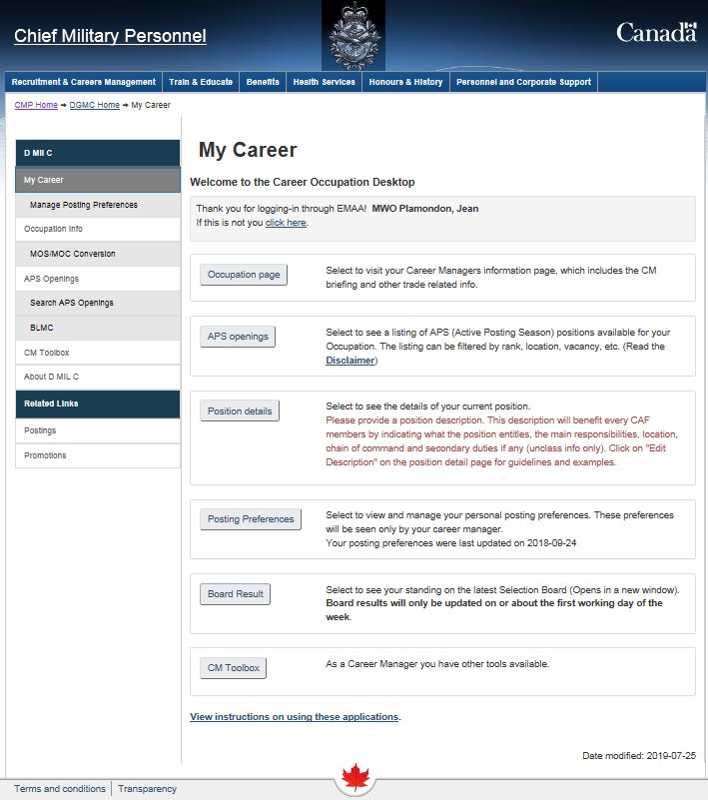
ONLINE CM
Employee Member Access Application (EMAA)
“My Career” link opens personalized DGMC web page.

Slide 26
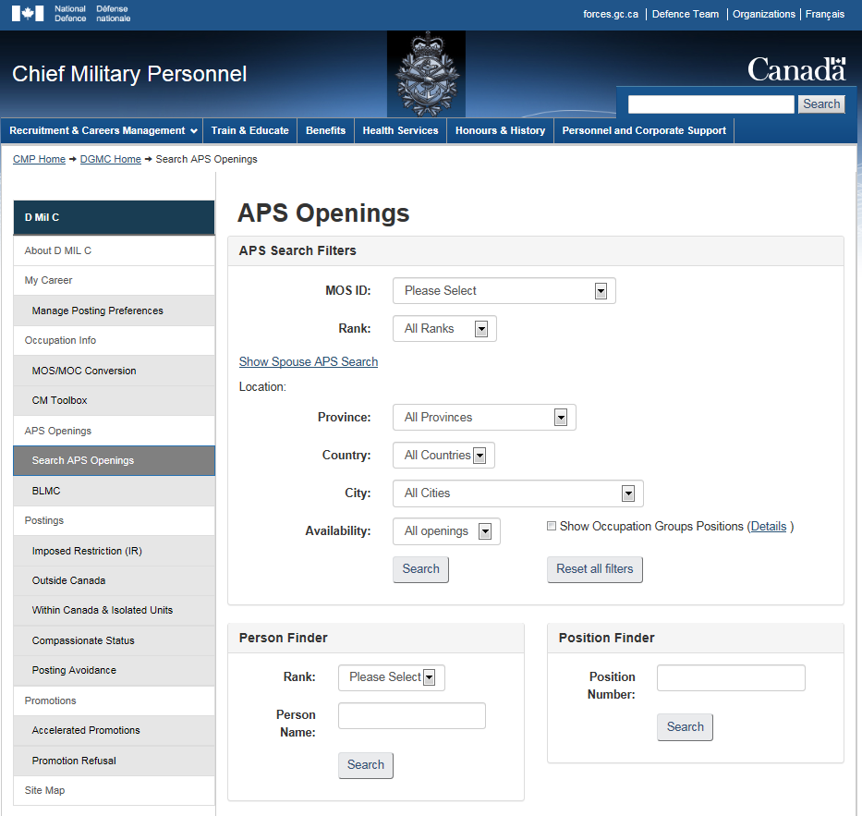
ONLINE CM
APS Openings Tool
Web-based tool to disseminate information on employment opportunities for the next and future APS
Available on DIN/DWAN through DGMC website or EMAA
Link: DGMC – APS Openings
*****

Slide 27
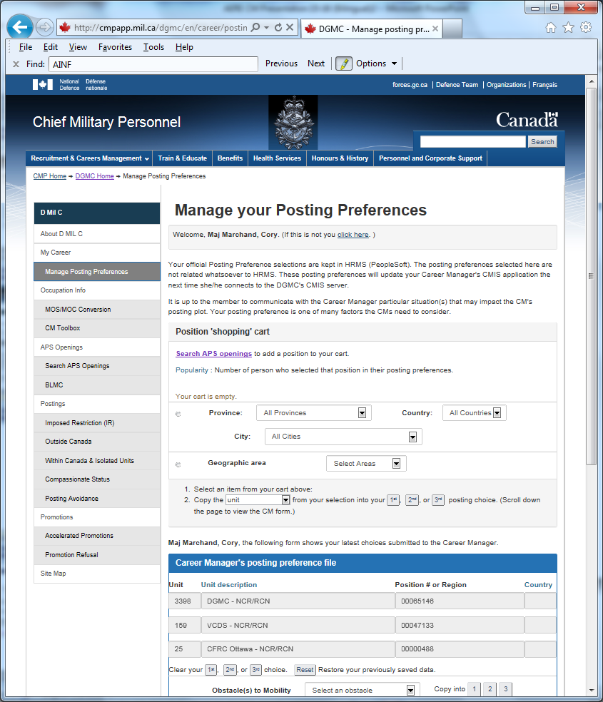
ONLINE CM
EMAA
Manage Posting Preferences
“Drag & Drop” functionality so you can enter remarks for your CM
Upload into CM systems within one week of entry
Pop-up window advises CM of new remarks
Notes:
Updated Sept 2019

Slide 28
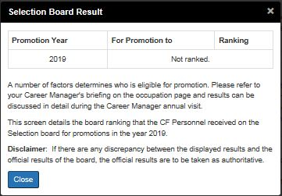
ONLINE CM
Selection Board Results
This window will be displayed separately from the main window
The information will not be stored by the browser
Colonel 1
Notes:
Updated Sept 2019

Slide 29
Promotions
Ref: Selection Board – OPI DMCSS 2
Notes:
Updated Sept 2019

Slide 30
SELECTION BOARD CANDIDATE LIST PROCESS
GETTING TO THE BOARD
Dot count last 3 PERs for total score out of 300
Ranked in decreasing score
The cut-off line is drawn at a minimum of 2x the forecasted number of promotions.
Force test validity no longer a pre-requisite to have file seen at the board
Results are available through EMAA two to three weeks after the end of the board
Notes:
Updated Sept 2019

Slide 31
PROMOTION BOARD SCORING
(ACSO)
CAPT MAJ
Performance / Rendement
  Last 3 PERs+ 60 60
Potential / Potentiel
  Second Language / Langue seconde* 4 5
  Leadership 13 12
  Prof. Dev. / Perf. prof.** 7 7
  Experience / Expérience*** 10 10
  Rankings 6 6
Total 100 100
Notes:
Typical of RCAF Officer SCRITs – Newly implemented Harmonized SCRITs mean that most occupations have similar point totals
*Scored automatically. No points for Expired Profile
RANK TARGET PROFILE MAX SCORE
CAPT → MAJ B A B 4
MAJ → LCOL B B B 5
**Professional Development – Used to be 4 pts excluding Education. Now includes Education and courses for 7 total points.
***Experience – Trade specifies if they want specific positions to be recognized – now worth 10 pts (vs 12 in previous SCRIT)
For professional certifications, ensure that it is put onto your MPRR / Pour des certificats professionnels, assurez-vous que c’est indiquer sur votre SDPM.

Slide 32
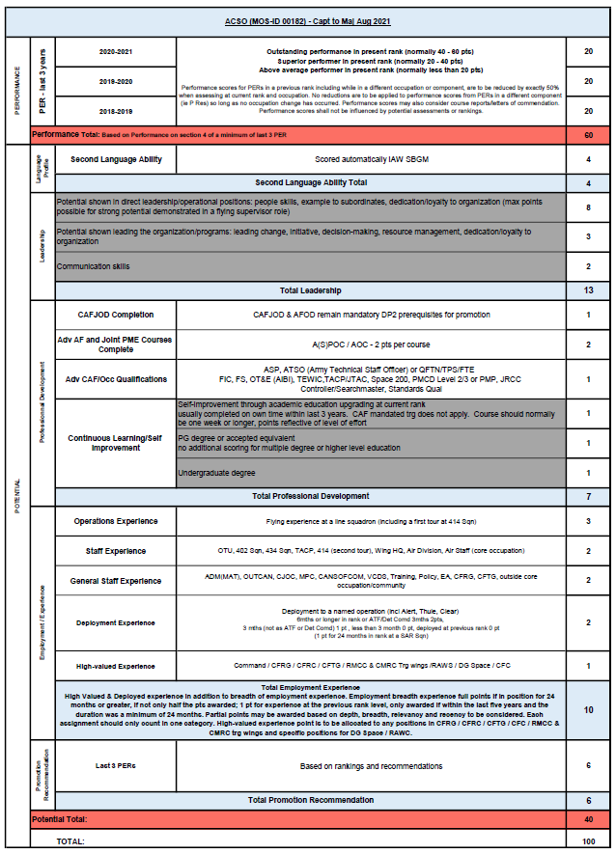
Scoring Criteria (SCRIT)
Reviewed by OA, approved by C Air Force and DMCSS 2 (for DGMC)
Files scored against SCRIT, not each other
Directors / CMs may clarify certain nuances for MOSID
Range of employment for max performance points is explained for MOSID
The assessment of the files is largely subjective less those categories which are objectively scored:
  Language (SOL)
  Education
  PD (JCSP or not)
Some Notable Changes this year
Notes:
Reviewed by OA, approved by C Air Force (DGAS) and DMCSS 2 (for DGMC)
Rate to the standard in the SCRIT, not to each other
Performance based on qualitative write-up, not DOT-counting
SL scored automatically IAW SBGM (can be adjusted if valid profile not reflected in HRMS)
ACSO Aide-memoire at your disposal
Draw attention to PER years under ranges of employment
Guide produced using CMIS and MPRR
Leadership – flying vs. non-flying?
Professional Development – Mil quals & courses in FY
Employment / Experience – binary vs. subjective; Command = APAB
Education – in last 3 yrs; PLARs accepted; no points for qualifications being sought

Slide 33
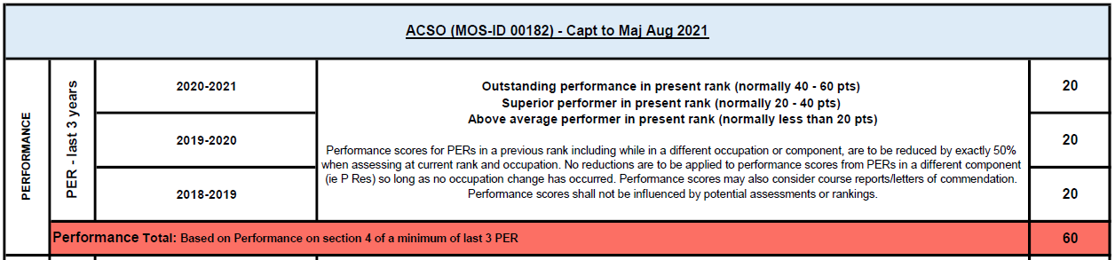
Scoring Criteria (SCRIT)
PERFORMANCE:
60 Points total (last 3 years):
  20 Points per year
  Previous year’s score for PER(X)
Performance per Narrative – not dot scores and not influenced by Potential, Ranking or Recommendation sections
All subsequent categories fall under POTENTIAL
Notes:
PER(X) – carry over last valid score if PER(X).
If no score within previous 5 years, score is zero
Subject to Variance control (5 pts) – resolved through discussion, not mathematically
Same for Capts and Majs

Slide 34
Scoring Criteria (SCRIT)
SECOND LANGUAGE:
4 Points Capt to Major
5 Points Major to LCol
Scored automatically IAW set guidelines
Auto-loaded from HRMS – Assuming results current on day 1 of Board
Will need to manually override for very recent results
Capts
Majs
READING | WRITING | ORAL | SCORE
B | A | B | 4
A | A | B | 3
A | A | A | 2
-- | -- | A | 1
-- | -- | -- | 0
READING | WRITING | ORAL | SCORE
B | B | B | 5
B | A | B | 4
A | A | B | 3
A | A | A | 2
-- | -- | A | 1
-- | -- | -- | 0

Slide 35
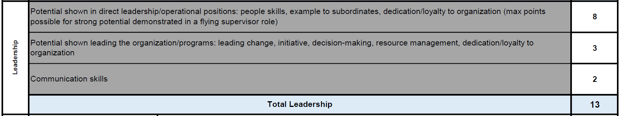
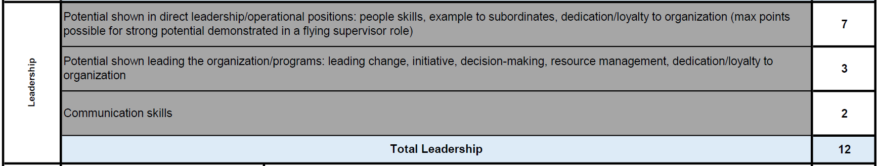
Scoring Criteria (SCRIT)
LEADERSHIP:
13 Points Capt to Major
12 Points Major to LCol

Slide 36
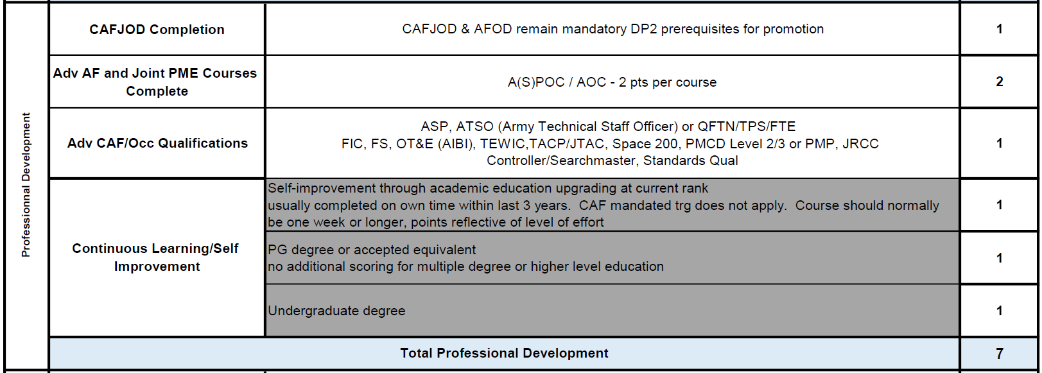
Scoring Criteria (SCRIT)
PROFESSIONAL DEVELOPMENT:
7 Points Capt to Major
Notes:
Need to establish guidance on how to assign points for Adv CAF / Occ Quals – only 1 pt. Some Board President discretion if needed.

Slide 37
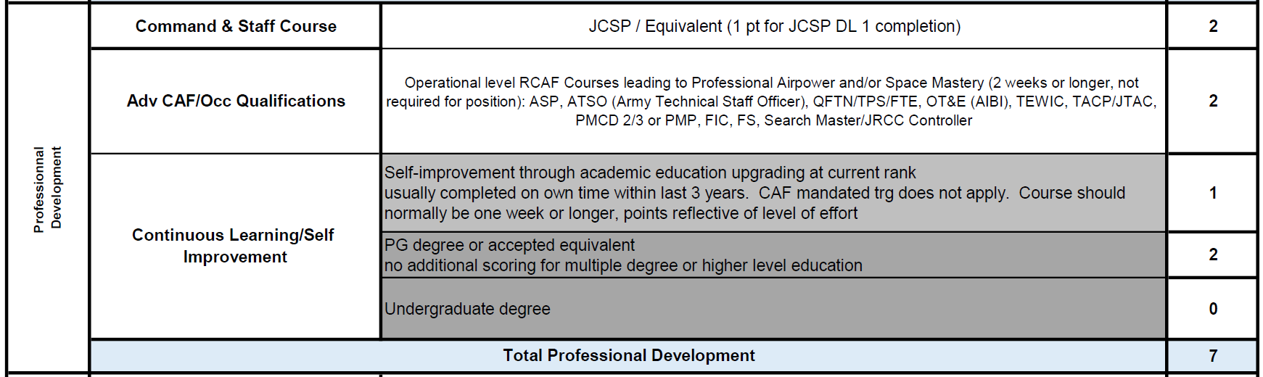
Scoring Criteria (SCRIT)
PROFESSIONAL DEVELOPMENT:
7 Points Major to LCol
Notes:
Need to establish guidance on how to assign points for Adv CAF / Occ Quals – only 1 pt. Some Board President discretion if needed.
SCRIT deviates from SBGM (says 1 pt Adv CAF/Quals, 2 pts for Continuous Learning) – acknowledge in Board Report or specify for scoring.

Slide 38
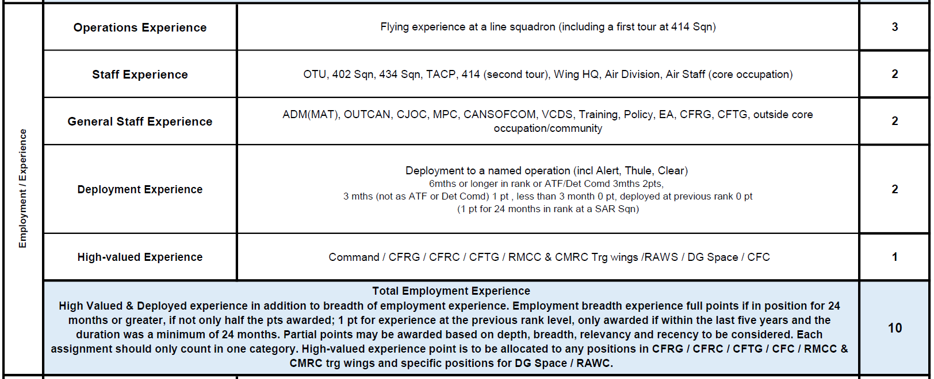
Scoring Criteria (SCRIT)
EMPLOYMENT / EXPERIENCE:
10 Points Capt to Major
Notes:
Note 24 Month guideline. CFC and RAWC – Limited Capt positions – Capture in Board Report?
“Only half the points awarded” for less than 24 months – is 12 months required for 1 pt?
High-Valued Experience – 12 months or 24 Months in px for point? Any amount of time?

Slide 39
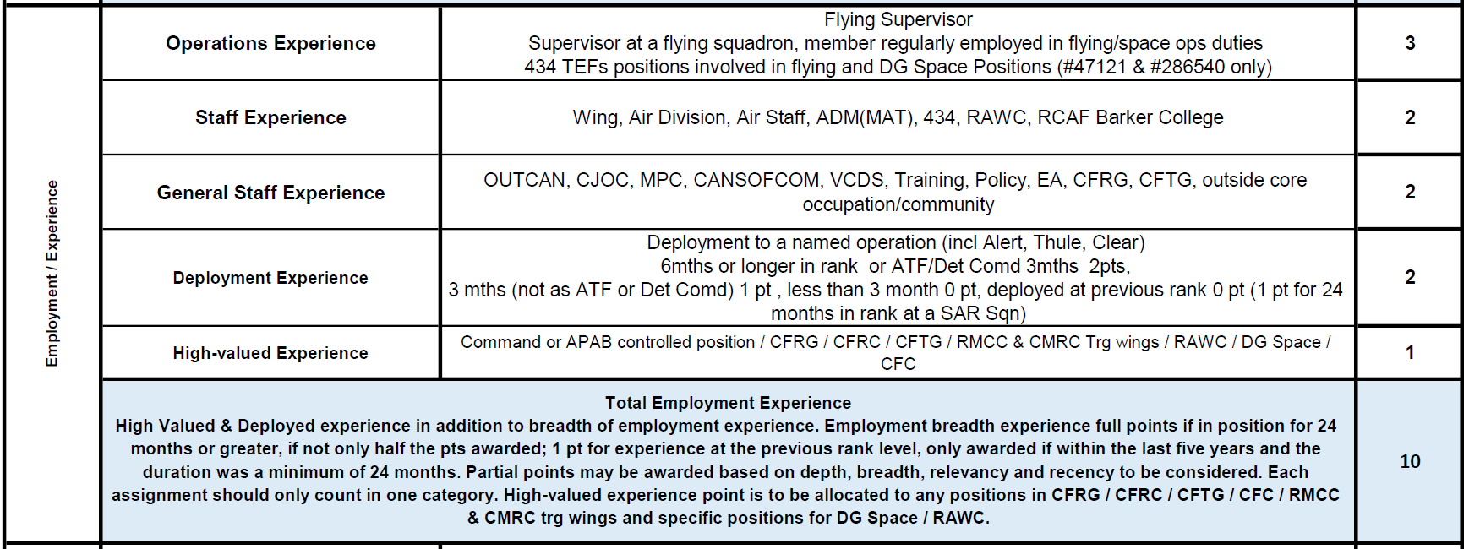
Scoring Criteria (SCRIT)
EMPLOYMENT / EXPERIENCE:
10 Points Major to LCol
Notes:
Note 24 Month guideline. CFC and RAWC – Limited Capt positions – Capture in Board Report?
“Only half the points awarded” for less than 24 months – is 12 months required for 1 pt?
High-Valued Experience – 12 months or 24 Months in px for point? Any amount of time?

Slide 40
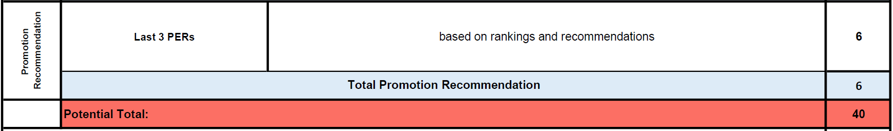
Scoring Criteria (SCRIT)
PROMOTION RECOMMENDATION:
6 Points Capt to Major
6 Points Major to LCol
Notes:
Not to be given based strictly on Rankings

Slide 41
QUESTIONS?
Notes:
PaCE
Acting While So Employed

